Slide 1
caBIG® Integration Hub-MirthConnect Assessment
Ekagra Software Technologies
July 15, 2010

Slide 2
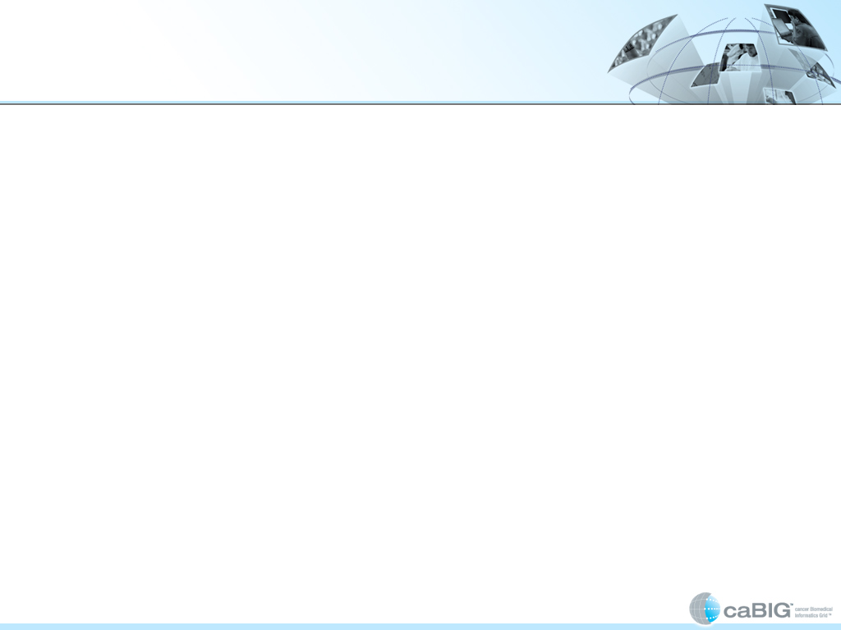

Purpose
Compare caBIG® Integration Hub (iHub)* and MirthConnect (Mirth) against a standard set of features
Evaluate and estimate options to start supporting User Interface, Database Integration and additional HL7v2 capabilities
* For this comparison caBIG Integration Hub(iHub) includes the capabilities of iHub and Cancer Center Hub Client (CCHC).
Ekagra

Slide 3
Summary of the Assessment
Differences between the products at a high level:
Options for closing the functionality gap:
Implement custom components in MirthConnect to support integration with caGrid Services, add pre-configured channels for caBIG® Clinical Trials Suite and caTissue Integration
Enhance iHub/CCHC solution to provide MirthConnect like functionalities
iHub/CCHC | Mirth
Provides integration for caGrid Services caBIG® Clinical Trials Suite caTissue API HL7v2 capabilites limited to lab data | Provides support for Comprehensive HL7v2 and other non-xml based standards Database integration Provides administration user interface for defining integration scenarios
Ekagra

Slide 4
iHub/CCHC – MirthConnect (Mirth)
Feature Comparison
Feature | iHub/ CCHC | Mirth | Comments
caGrid Secure services Integration | √ | Χ | iHub supports grid, non-grid and multi-grid integration scenarios iHub components enabling grid integration, can be migrated to Mirth
Suite and caTissue integration scenarios | √ | Χ | After adding custom components, Mirth can support these integration scenarios
HL7v3 | √ | √ | Both support receiving, routing and transforming HL7v3 messages Mirth provides the user interface for creating transformations and filtering of HL7v3 messages
HL7v2 | √ | √ | Mirth support includes validation, filtering, receiving , generating and transforming of all HL7v2 messages Mirth includes a built-in HL7v2 parser and also supports external parsers such as HAPI iHub/CCHC support conversion of only Lab Results HL7v2 to HL7v3 iHub/CCHC can provide comprehensive support for HL7v2 using tools such as caAdapter and HAPI
Ekagra
√ = Full Support, √ = Limited Support, Χ = No Support

Slide 5
iHub/CCHC – MirthConnect (Mirth)
Feature Comparison
Feature | iHub/ CCHC | Mirth | Comments
Other Standards: - Delimited Text - X12/EDI - DICOM - NCPDP PDF | √ | √ | CCHC supports conversion of comma delimited lab data to HL7v3 iHub supports only XML based messages Mirth supports receiving, filtering and transformation of the listed payload formats. Validation is supported for NCPDP format
Administration User Interface (UI) | √ | √ | Mirth Administration UI provides a number of features: Defining new integration scenarios (channels) Defining filters Defining Transformations Deploying integrations on the MirthConnect server Monitoring the server and messages flowing through Submitting test messages Re-submitting failed messages Starting and stopping individual channels iHub does not provide an Administration UI CCHC provides a UI for making configuration changes
Ekagra
√ = Full Support, √ = Limited Support, Χ = No Support

Slide 6
iHub/CCHC – MirthConnect (Mirth)
Feature Comparison
Feature | iHub/ CCHC | Mirth | Comments
Database Integration | Χ | √ | Mirth support includes generic integration with any database that supports JDBC Mirth provides a user interface for mapping message elements to database columns and creating database queries
Transport Protocols HTTP HTTPS JMS Email FTP, SFTP SOAP MLLP* | √ | √ | iHub supports all, with the exception of MLLP Mirth supports all, with the exception of HTTPS; Mirth Appliances which are offered commercially provide out of the box support for HTTPS
Transformation | √ | √ | iHub supports only XSLT-based transformations CCHC supports transformation of HL7v2/CSV based lab data to HL7v3 Mirth does not use XSLT but uses proprietary implementation. Mirth supports transformation of non-xml data as well
Ekagra
√ = Full Support, √ = Limited Support, Χ = No Support

Slide 7
iHub/CCHC – MirthConnect (Mirth)
Feature Comparison
Feature | iHub/CCHC | Mirth | Comments
Auditing and Logging | √ | √ | Mirth user interface for viewing audit messages and events is tightly integrated with the underlying ESB; allowing for much more functional UI for accessing and purge logs iHub uses Common Logging Module (CLM) based Log Locator Tool (LLT) for querying audit logs
Re-submission of messages | Χ | √ | Any message including those that failed can be re-submitted through the administration GUI
Routing support | √ | √ | iHub includes routing support for most enterprise integration patterns Mirth supports one generic pattern
Payload (Input message) Validation | √ | √ | iHub supports XML schema based payload validation Mirth supports validation for HL7v2 and NCPDP payload formats
Ekagra
√ = Full Support, √ = Limited Support, Χ = No Support

Slide 8
iHub/CCHC – MirthConnect (Mirth)
Feature Comparison
Feature | iHub/CCHC (Servicemix) | Mirth (Mule) | Comments
Extensibility | √ | √ | iHub supports extensions using JBI specifications Mirth uses Mule extension/plug-in mechanism
Clustering and failover | √ | Χ | Commercial Mirth Appliances provide out of the box support for clustering and failover
Message Reliability | √ | √ | iHub - Automatic recovery from a failure such as power failure Mirth - Support for resubmission after a connectivity
Ekagra
√ = Full Support, √ = Limited Support, Χ = No Support

Slide 9
Solution Alternatives
A. Port iHub to MirthConnect | B. Enhance current iHub/CCHC
Tasks: Implement custom components for caGrid integration Implement support for https Implement (Configure) iHub integration channels in Mirth Migrate integration smoke test and other supporting code to work with MirthConnect Modify Mirth UI to include caBIG® branding High Level LOE Estimate: 4 Person Months - Development | Tasks: Implement database integration component Implement comprehensive support for HL7v2 and non-XML payloads Implement an administration GUI with the following features: Ability to create new routes and transformations Ability to monitor messages Ability to start/stop integration scenarios Ability to re-submit failed messages High Level LOE Estimate: 6 Person Months – Development
Note: If the MirthConnect option is selected, we recommend a 1-month Proof of Concept phase to implement one integration scenario, verify licensing terms and confirm the overall LOE estimate.
Ekagra

